Slide 1
Counting High Photon Numbers with a TES
Miller Eaton

Slide 2
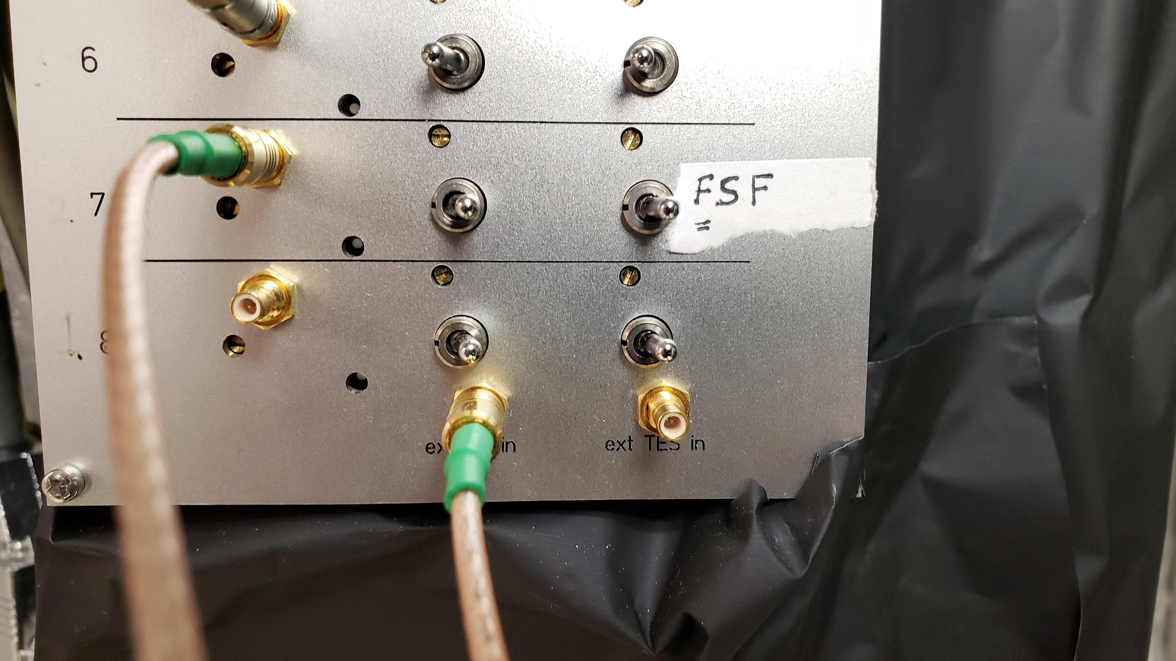
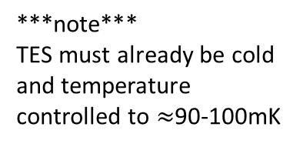
Biasing
***note***
TES must already be cold and temperature controlled to $≈$90-100mK
To bias from scratch, start with ALL 3 bias screws turned counter-clockwise until a very quiet ‘click’ is heard
Flip switches to the right on channels being biased
Send a triangular wave 2V pk-pk at 100Hz to ext fb in
Also send this same signal to port 1 of an oscilloscope
Send the TES output from the channel you wish to bias to port 2 of the oscilloscope

Slide 3
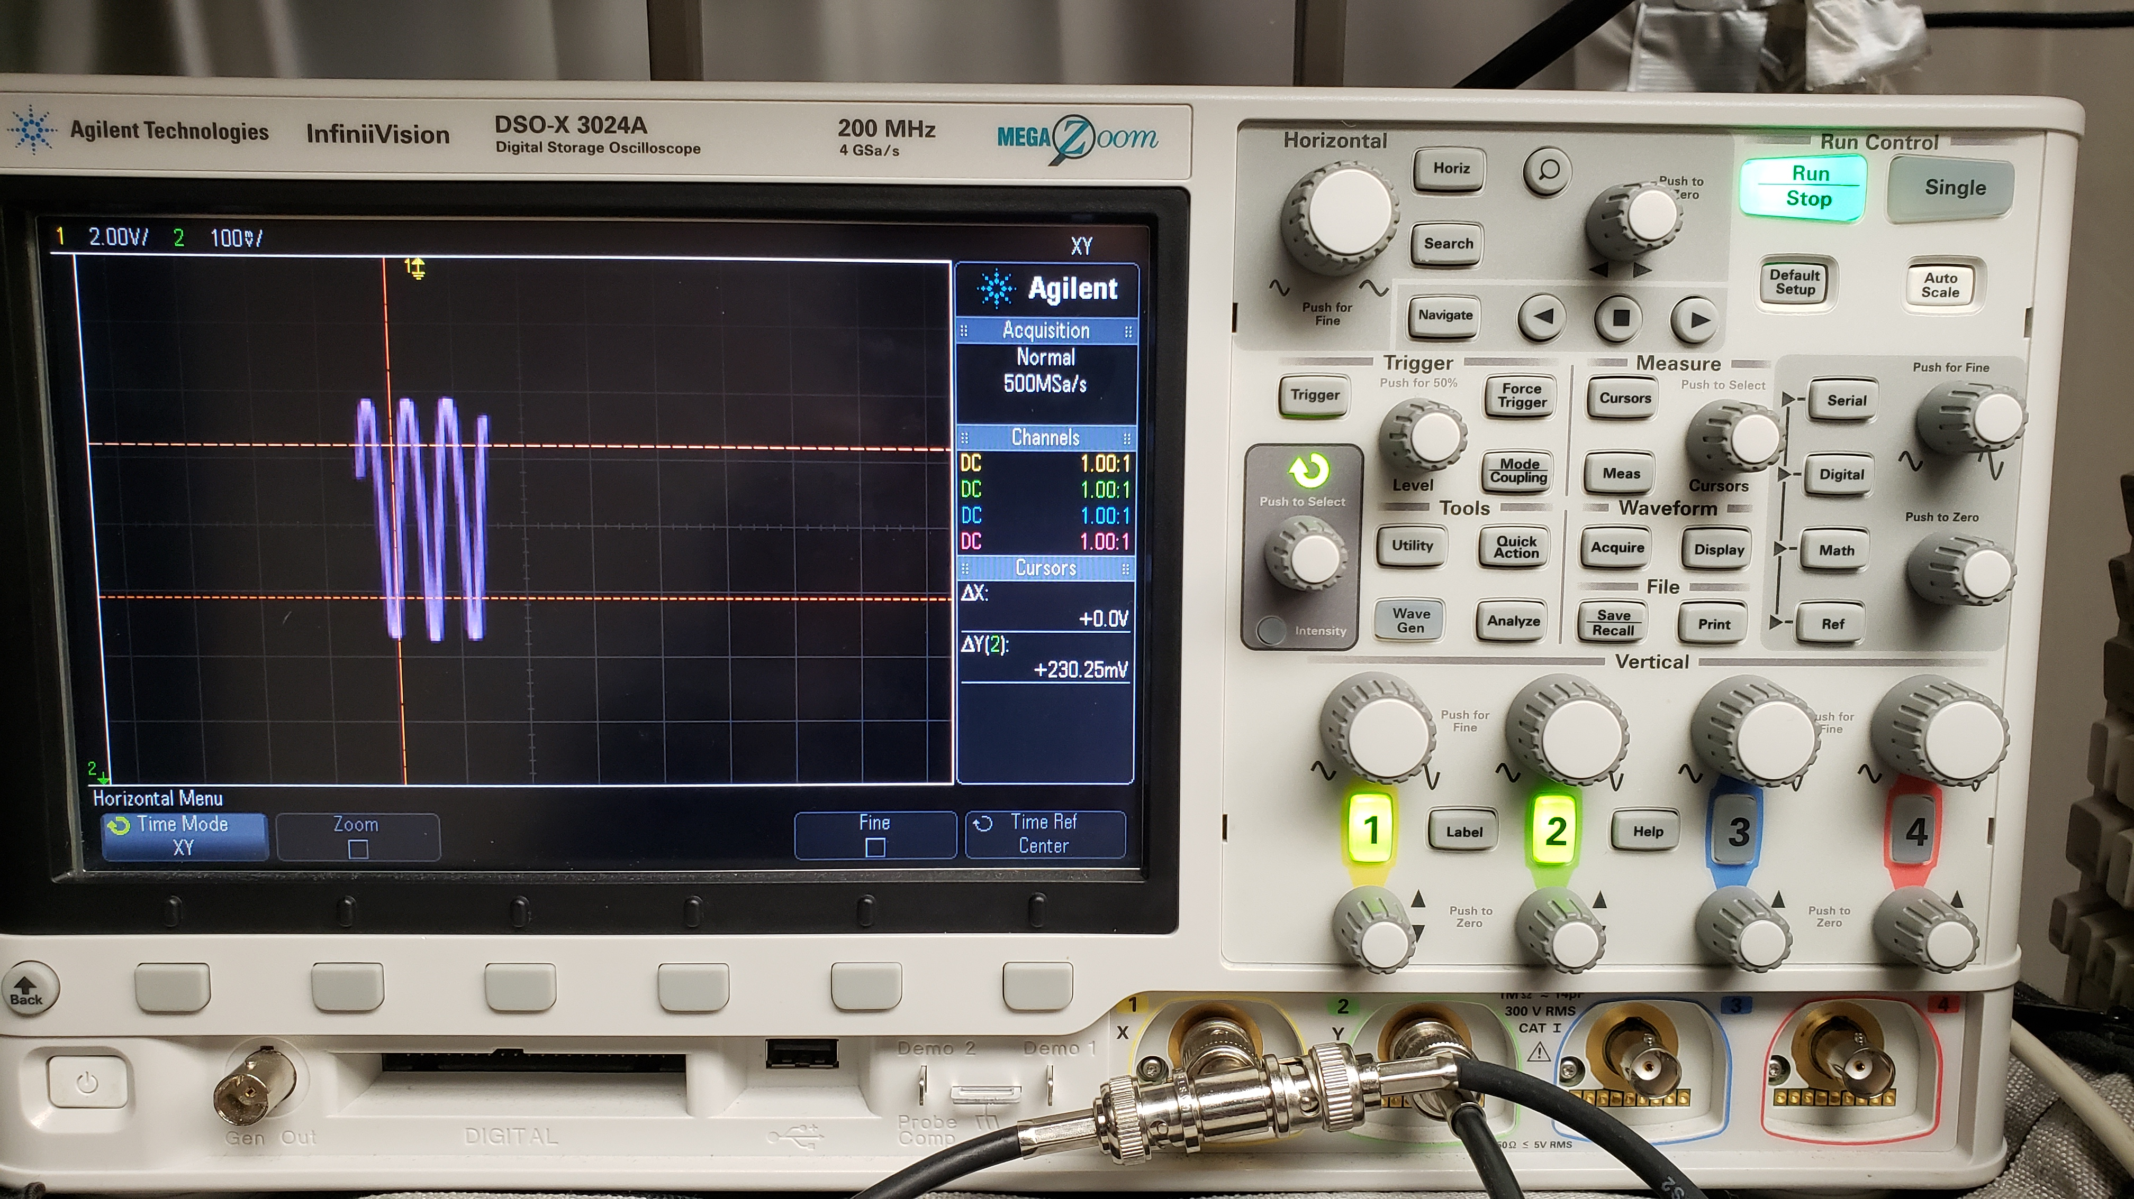
Push the Horiz button on the oscilloscope
Choose Time Mode XY

Slide 4
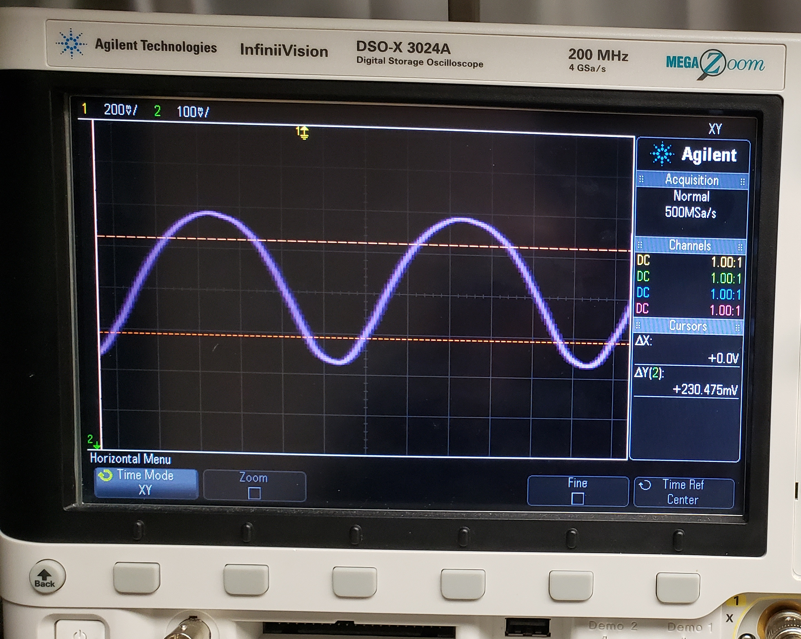
Turn the SQUID bias screw clockwise until the pk-pk fringes are maximized
After maximizing fringes, it is a good idea to set reference markers on the max and min

Slide 5
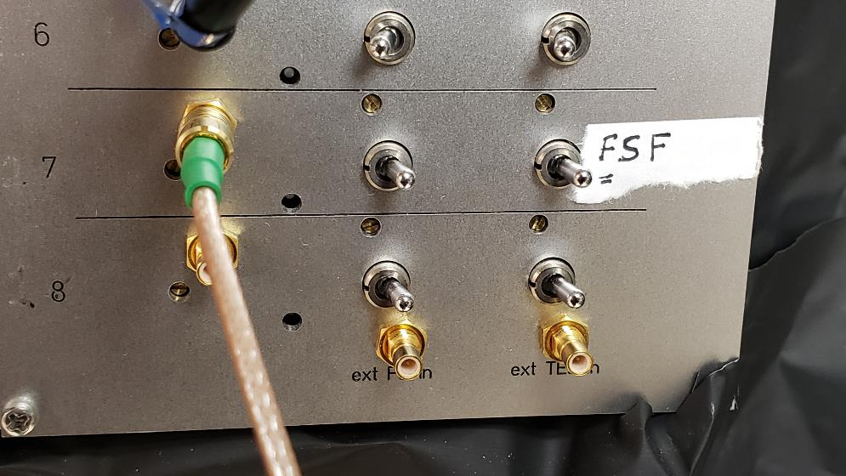
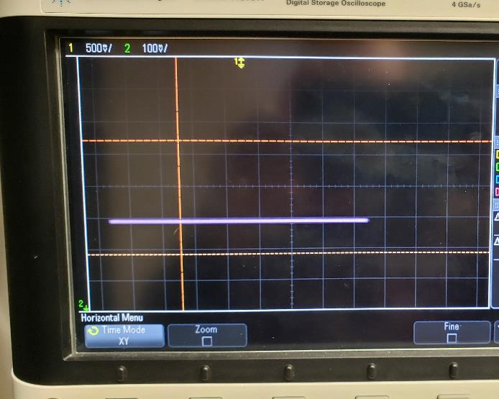
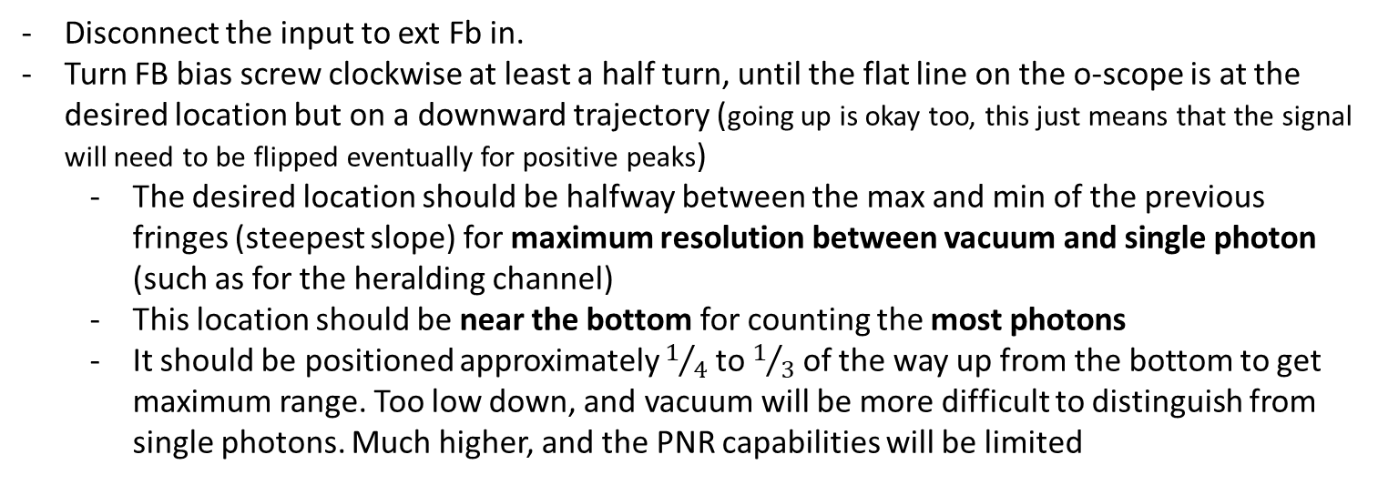
Fringe max
Set about here for max PNR abilities
Fringe min
Disconnect the input to ext Fb in.
Turn FB bias screw clockwise at least a half turn, until the flat line on the o-scope is at the desired location but on a downward trajectory (going up is okay too, this just means that the signal will need to be flipped eventually for positive peaks)
The desired location should be halfway between the max and min of the previous fringes (steepest slope) for maximum resolution between vacuum and single photon (such as for the heralding channel)
This location should be near the bottom for counting the most photons
It should be positioned approximately $1/4$ to $1/3$ of the way up from the bottom to get maximum range. Too low down, and vacuum will be more difficult to distinguish from single photons. Much higher, and the PNR capabilities will be limited

Slide 6

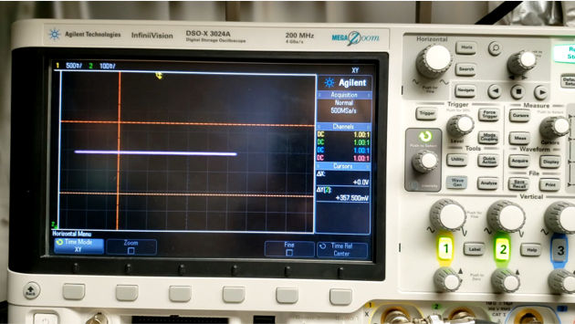
Turn TES bias screw clockwise SLOWLY until the o-scope signal ‘snaps’ back to a prior position
Example video of the ‘snap’ for a case where the FB bias was set near the middle of the fringe (not ideal for max PNR). The video file is named as bias_snap.mp4 in this folder.

Slide 7
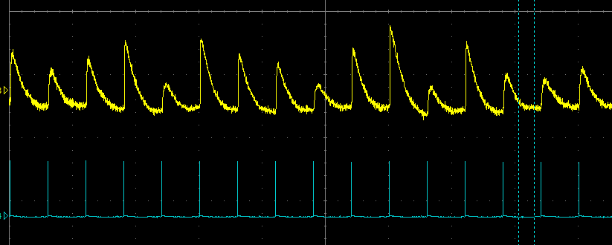
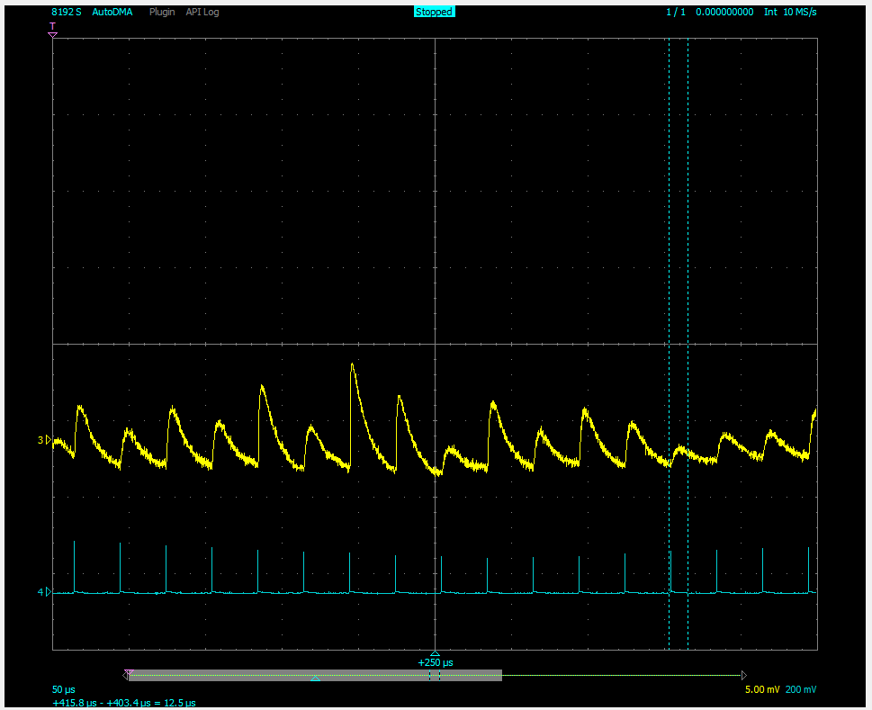
Send the TES output to Alazar (or some other oscilloscope to easily visualize the signal in real time)
Send a pulsed coherent state into the channel and watch the peaks
Continue to make small adjustment to the TES bias screw until the peak have the greatest visual differentiation.
Turning the screw too far clockwise and the peak become very narrow and start to all look the same
Too far counter-clockwise and the peaks become wide and difficult to differentiate 0 from 1
Good
Not Good
The difference is subtle, but the trace on the right shows the TES bias screw turned too far counter-clockwise. The peaks are slightly too wide, and the rising edge is less steep. The indicated peaks are more difficult to differentiate from random noise.

Slide 8
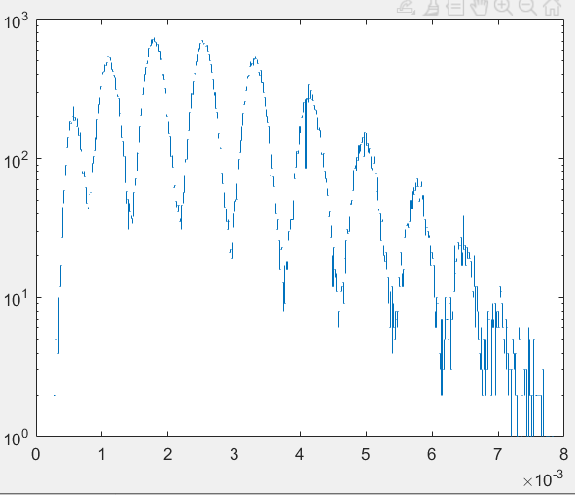
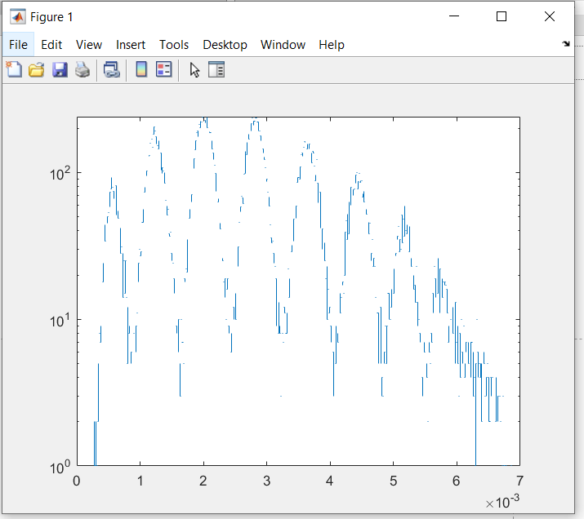
Location of fb bias effects
1
2
3
2
3
4
1
4
Counts
0
5
0
5
6
6
7
7
8
9
8+
10+
Voltage (a.u.)
Voltage (a.u.)
Low on the fringe: slightly worse 0-1 differentiation, but better PNR capabilities
Middle of the fringe: great 0-1 differentiation, and slightly better distinction between peaks overall, but lower maximum resolution
Example data location: \QFQI Lab Dropbox\Miller Eaton\QFQI data\2020\counting_high_photnum\

Slide 9
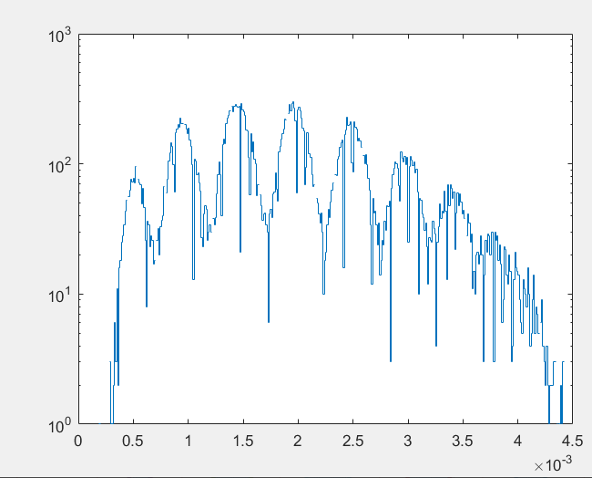
High on the fringe: not as good peak distinction as when on the middle of the fringe, and also lower max detection of photons
2
3
1
4
0
5
6
7+
Example data location: C:\Users\mille\QFQI Lab Dropbox\Miller Eaton\QFQI data\2020\counting_high_photnum\high on fb bias\

Slide 10
Send a pulsed coherent state to TES of alpha~2 for about 1 sec to acquire data to calibrate the thresholds.
Acquire TES output on one channel, and TTL pulse signal on another channel
The coherent state should be slightly stronger than what you want to measure, so you can better calibrate the 8-10 photon number region. Run the code “pulse_counts_self_threshold.m” to fit the histogram to N Guassians and find the thresholds from the intersection points. These thresholds can then be used for all data in the set you take (same TES temperature and bias points)
- *note* it is advisable to manually double-check the thresholds by looking at the histograms manually in case of errors

Slide 11
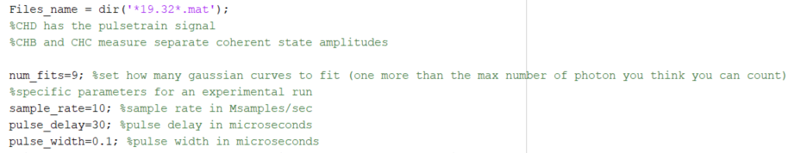
pulse_counts_self_threshold.m
Important to set these variables at the top of the file. The train of TTL pulse should be the last channel in the acquired data
After loading the data, the below code finds all location of TTL pulse signals around which to look for TES measured events
Set this value > 0 but just below the peak height of the acquired TTL signal. Note that depending on pulse settings, this might vary a little over the duration of the measurement, so be sure to set it low enough to count them all!

Slide 12
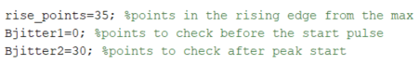
rise_points depends a bit on biasing and sample rate, but should account for roughly 2-3 us of data. I find for 10Mb/s sampling speed, that about 30 or 35 points is good. This parameter tells the code how far before each peak to look for the lowest baseline Voltage
Bjitter1 can usually be 0, but this tells the code how far before (or after) the TTL pulse there might be a TES signal. If there is some delay it is sometimes good to set Bjitter1 to a negative value to wait a few points after a TTL pulse before looking for a peak.
Bjitter2 tell the code how far after the TTL pulse to keep looking for a peak. In other words given a TTL pulse at LOC, the code looks for a peak in the interval [LOC-Bjitter1, LOC+Bjitter2]

Slide 13
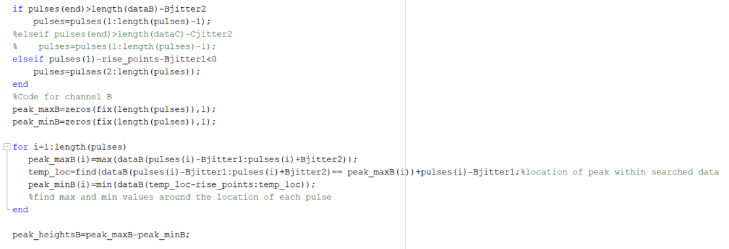
This chunk calculated the TES peak heights around each of the TTL pulses

Slide 14
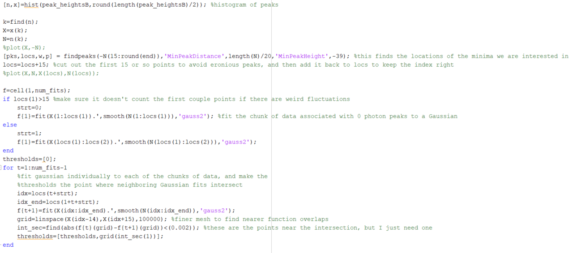
Code to fit Gaussians to each chunk of the histogram of peak heights – some parts may needing modifying depending on data. More details on next slide

Slide 15
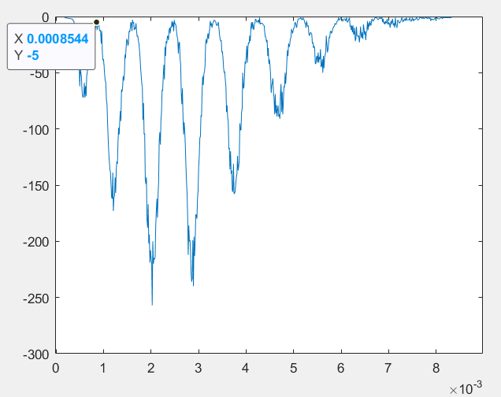
Could probably be written in a different and better way, but this generally works. It finds the locations of the dips in the histogram by flipping the distribution and finding the peaks.
This value ensure erroneous dips aren’t counted if they are too close together. Generally set somewhere between length(N)/12 and length(N)/20
Set to be just below the minimum inverted height you want too see (basically the absolute value of this parameter is the upper bound for the number of events in a given histogram bin). In this example it should be below -5, so maybe here it should be set to -8 or so just in case.
Avoids dips to close to 0, set slightly higher if need be, but make sure it’s the same in both spots (15 in this example)

Slide 16
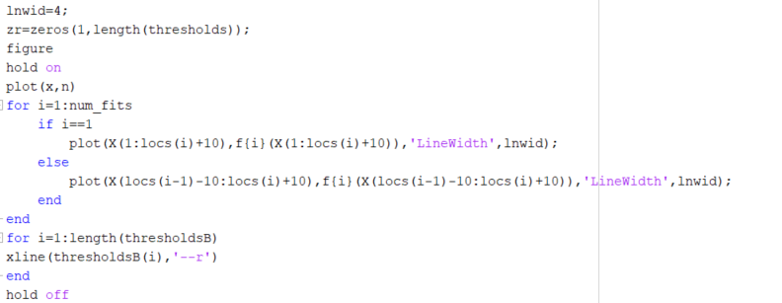
Plotting stuff

Slide 17
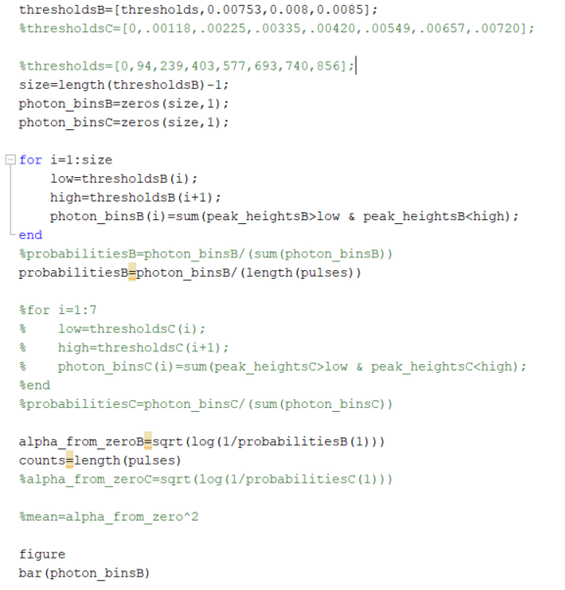
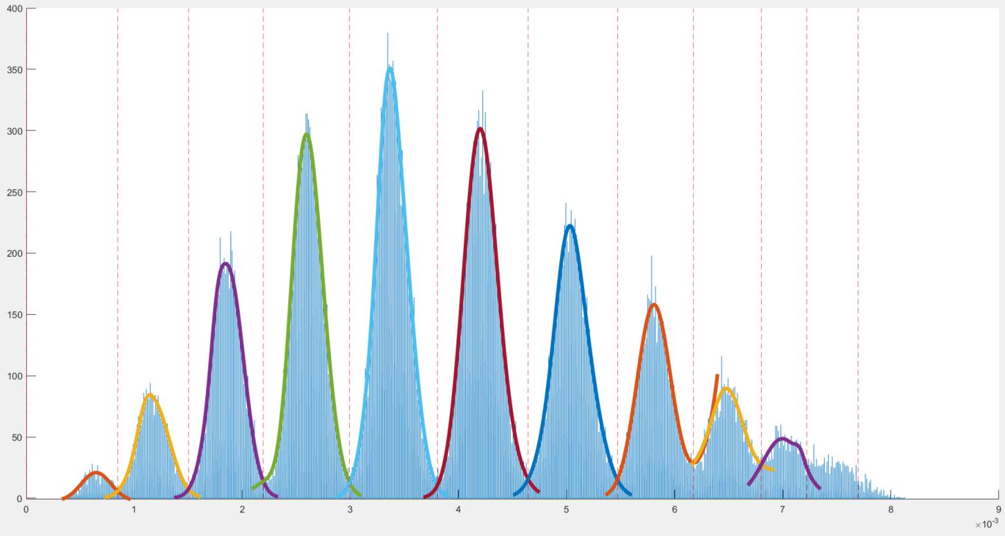
Turn peak heights into photon numbers based on the thresholds from calculated Gaussians. There isn’t usually enough data at the end to fit gaussians to the last peak or define and upper bound on thresholds at which to truncate, so it’s usually good to manually zoom in and pick the last 1-2 thresholds.
Append end manual thresholds here:
probabilitiesB contains the measured distribution
From fit
manual
manual
8
9
alpha_from_zeroB calculates the coherent state amplitude
10
the code length(pulses) will return the total number of events in the distribution

Slide 18
Histogram with Gaussian Fits
4
4
5
5
3
3
6
6
2
2
Counts
1
1
7
7
0
8
9
10
Voltage (a.u.)
Example Data located at: \QFQI Lab Dropbox\Miller Eaton\QFQI data\2020\counting_high_photnum\best

Slide 19
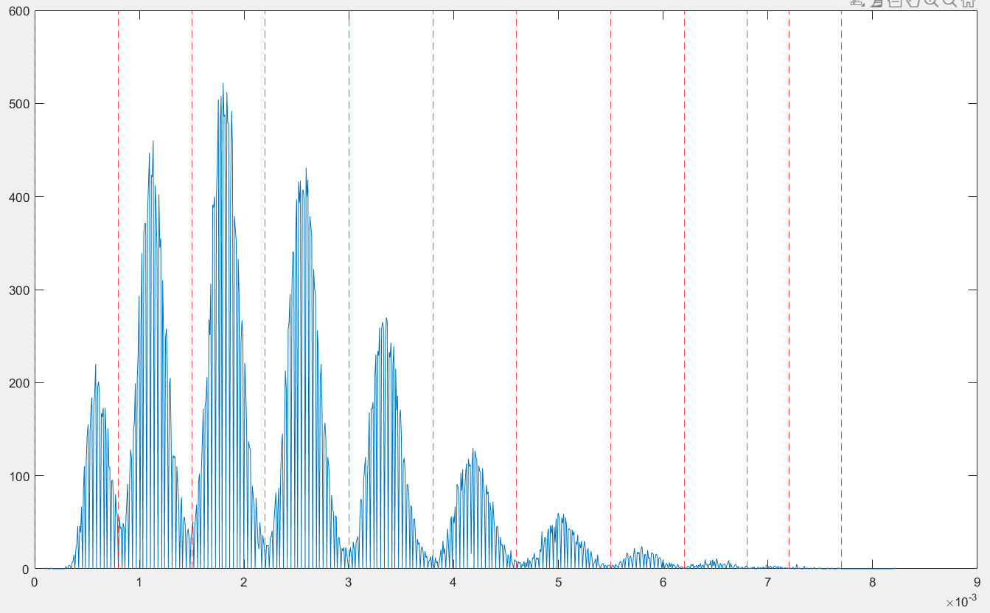
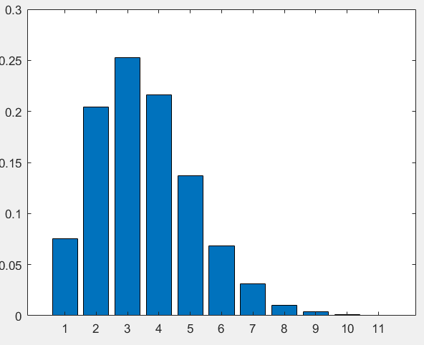
0 1 2 3 4 5 6 7 8 9 10
Example using the same thresholds calculated from the previous distribution Gaussian fits (red dotted lines),
But now with a weaker coherent state. The distribution has a fidelity of > 0.999 with a theoretical coherent state obtained with alpha=1.6075 obtain from only the zero photon probabilities.

